Slide 1
成功的蛻變
From an Average Person to a Successful Leader
Sharon Liang
高級顧問經理級 Director
四個佣金週期共賺取HK$138,000
HK$138,000 in 4 Commission weeks
本簡報中提到的收入等級純屬舉例說明，無意代表美安香港超連鎖店主的一般收入，也無意表示任何超連鎖店主皆可賺取同等收入。美安香港超連鎖店主的成功與否，取決於其在發展事業時的努力、才能與投入程度。The income levels mentioned in the following presentation are for illustration purposes only. They are not intended to represent the income of a typical Market Hong Kong UnFranchise Owner, nor are they intended to represent that any given Independent UnFranchise Owner will earn income in that amount. The success of any Market Hong Kong Independent UnFranchise Owner will depend upon the amount of hard work, talent, and dedication which he or she devotes to building his or her Market Hong Kong Business.

Slide 2
美安事業為什麼普通人能做?
Why average person can do the business?

Slide 3
我能做到嗎? Can I make it?
看到別人成功﹐盡快把不相信變為相信
Seeing others succeeded, change your mind and trust it

Slide 4
可行的系統 The proven system
多元化的產品﹐消費轉收入
Variety of products, convert spending into earning
網路平台 Internet platform
團隊 Teams

Slide 5
普通人成為領導者
Average person becomes a leader
要有成功人士的思維
Has the mindset of successful man

Slide 6
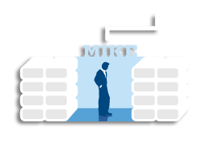
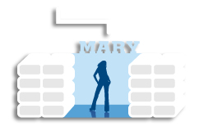
永續收入来自一個穩固的團隊 Residual income from a Stable Team
Notes:
6
Talking Points
Teach, manage, and support other people’s success
Teach each person how to Apply, Create, Qualify and Activate
By sponsoring more than two Independent Distributors, you help others succeed, while speeding up your success
As new Independent Distributors are added to your organisation, you are expanding distribution and further leveraging time
Success through Distribution…”I would rather have 1% of the efforts of 100 people than 100% of my own efforts” – J. Paul Getty
In order to be successful:
Have a product that everybody wants and needs
Be your own boss
Duplicate yourself

Slide 7
BV + 人 ≠ 網絡
BV + People ≠ Network

Slide 8
領袖LEADER + 領袖LEADER
=
網絡Network

Slide 9
領導的定義是什麼？ What is the definition of leadership?
真正的領導，帶着一群人實現共同的目標
Leader Follower
任何成功者都有一個很好的導師，在導師身上吸取成功經驗
A leader would achieve a common goal with the team
Leader Follower
Successful leaders would have a good mentor and learn successful experience from the mentor
Notes:
好

Slide 10
領導者的特質 The Characteristics of Leaders
自信一不抱怨、樂觀、熱情、積极正面
專業一穿着、談吐、學習要到位
精通基本功
管理高手，情緒、財務、時間
溝通高手
心胸廣闊
Be confident, optimistic, enthusiastic, positive & don't complain
Be professional: smartly dressed, well-spoken, knowledge
Proficient in basic skills
Management expert: emotional, financial, time
Communication expert
Broad minded

Slide 11
带領團隊 Lead the team
講該講的話
做該做的事
去該去的地方
Speak the right words
Do the right things
Go the right places

Slide 12
有效時間管理 Effective Time Management
賣票是最有效的時間管理
捷徑中的捷徑
買票和賣票
Ticketing is the most effective time management
The fastest shortcut
Buy and sell tickets

Slide 13
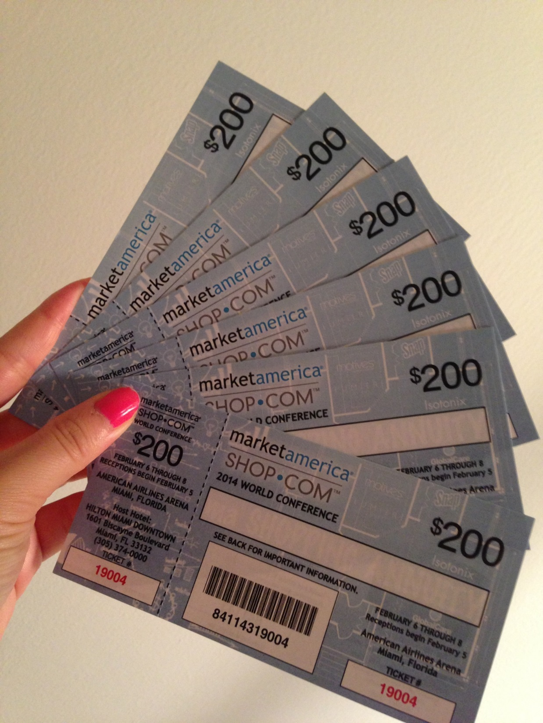

Slide 14
Building Leadership
Show up
每會必到

Slide 15
「靶心概念」
Target Concept
由外及内，
逐漸深入！
From the outside in,
Step by step
新超連鎖™店主訓練NUOT
成功五要訣訓練 B5
授證經理級訓練ECCT
一對一介紹 (One - on – Ones)
超連鎖事業説明會 (UnFranchise Business Presentations)
地方研討會 (Local Seminars)
區域大會 (District Conference)
轄區年會(Regional Convention)
世界大會 (World Conference)
國際年會 (I n t e r n a t i o n a l C o n v e n t i o n)
複
你的目標應該是帶領更多「積極進取型」超連鎖店主
參加下一次國際年會…但是一切要從外環做起…
三對一介紹，二對一介紹，一對一介紹
Your goal is to bring more “Go Now” UFO to the next International Convention….but start from the outside, 3 to 1, 2 to 1 and 1 to 1 presentations.
Notes:
15
15
15

